Slide 1

CEIR Distributor Training Manual

Slide 2

Agenda
Distributor - Definition and Overview
Assumptions
Features
Registration
Dashboard
Stock Management
Grievance
Profile Management

Slide 3
Distributor - Definition
Distributor is an entity who get the supply of SIM based devices from Importers.
Distributors do not interact with Customs directly for paying the duty
Distributor may or may not maintain the device details received from Importers
Distributor has to be legally registered entity with Department of Commerce (Government )
A distributor can be Importer and Retailer as well.
Distributors are required to interface with CEIR system to report the inventory of devices during grace period. Distributor could upload anonymously as well during the grace period.
Distributors are required to interface with CEIR after the grace to upload the stock. This interface is optional to use but built in the CEIR system.

Slide 4
Overview
Distributor has to register using DMC Home Portal
As part of registration process, distributor will receive the username and password which can be then used to login to the CEIR Portal
Once logged into the CEIR portal, distributor can use following features
Stock Management
Grievance Management
Profile Management
Distributor can see the status of ongoing activity through the Dashboard feature
Email Notification to keep track of the status of various operations

Slide 5
Distributor – Roles
Pls note Buying and selling of devices are done outside the scope of CEIR system.
As Distributor - Buy devices from other distributor or importer
As Distributor – Sell devices to other distributor or retailer
As Retailer – Sell devices to other retailer
As Retailer – Buy devices from other importer or distributor or retailer

Slide 6
Assumption
Following regulations will be implemented
For Distributors to register with CEIR system.
Companies that register as Distributors should have valid VAT registration.
Device upload based on the Invalid TAC information from the Distributor will be rejected.

Slide 7
Registration – Distributor
An Distributor can be a Cambodian national only.
A Distributor can register as
Individual → If registered as an Individual, National ID / Passport details are mandatory. Submission of VAT file is not mandatory in case of an Individual.
Company → If registered as a company, VAT details for the company are mandatory.
Distributor can select from any or all of the following roles
Retailer
Distributor

Slide 8
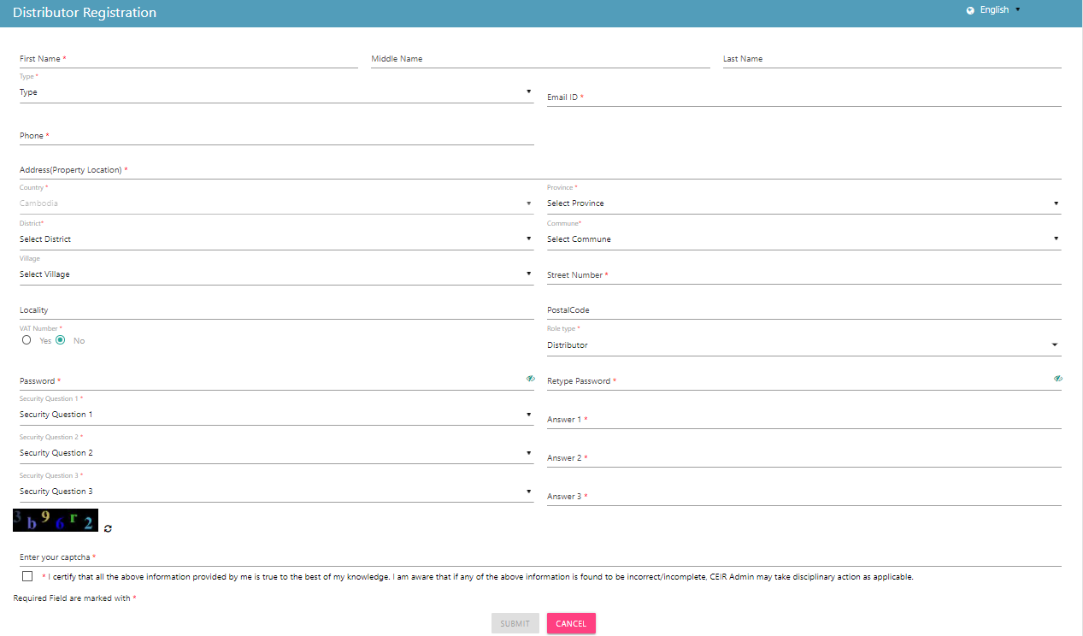
Registration – Distributor (Form)

Slide 9
Dashboard – Distributor
The Dashboard has information about the following
Stock requests uploaded by the Distributor
Total devices waiting for upload
Total Grievances raised by the Distributor
Notifications on feature requests raised by the Distributor

Slide 10
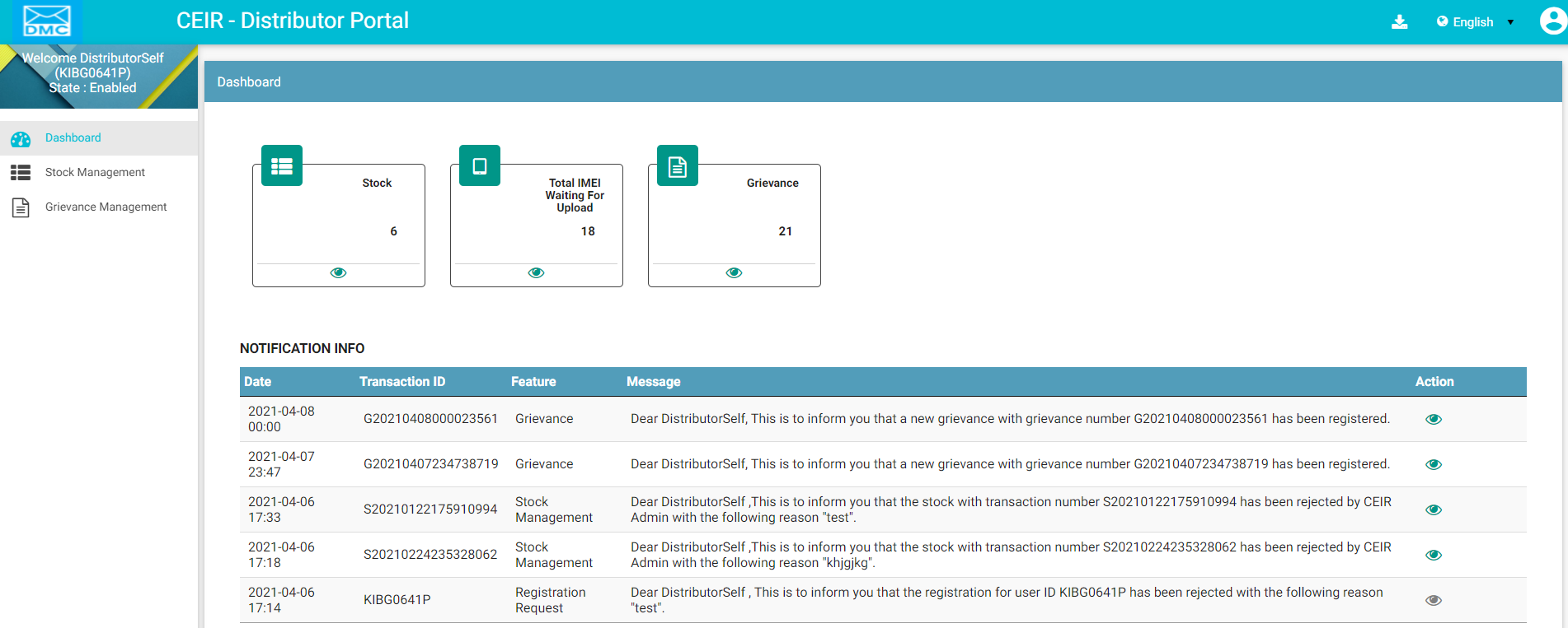
Dashboard – Distributor
Left Panel
Download User Manual
Work Area
All features status
Edit Profile
Language Change
Notifications
On click it takes user to respective home page

Slide 11
Stock Management – Distributor
Stock is uploaded to the system to be made available for sale.
Distributor can upload stock in post grace period as well as after the grace period.

Slide 12
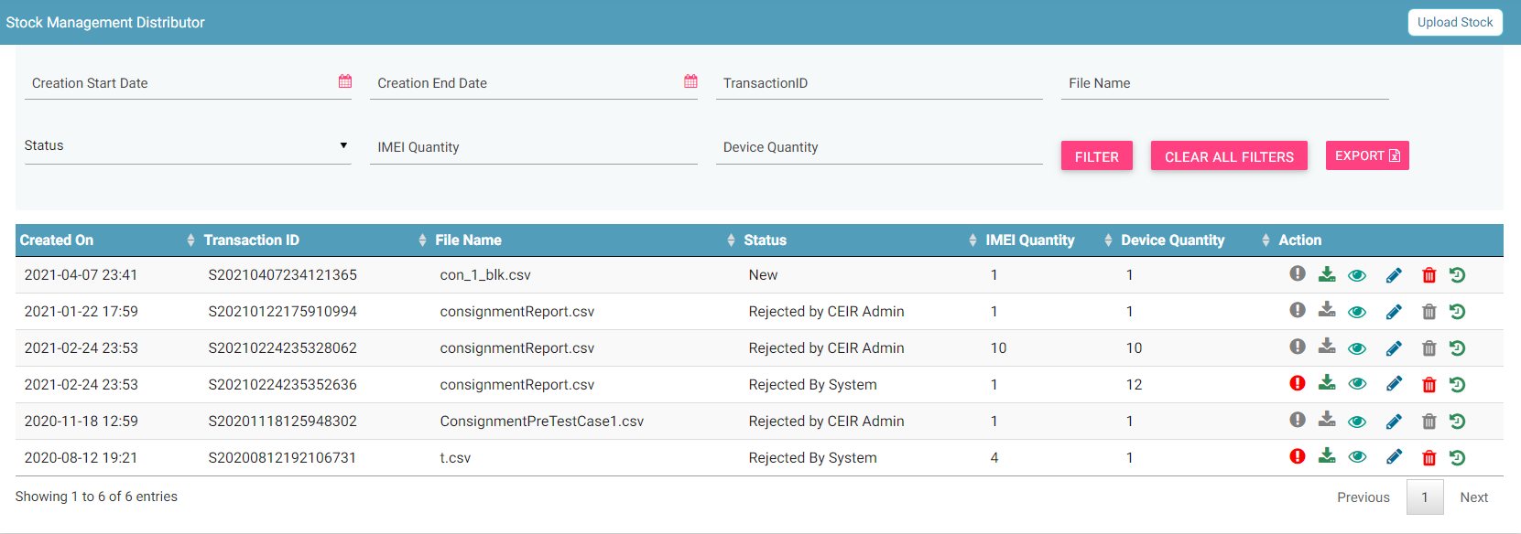
Stock Management – Distributor
Filters
Upload
Export
Action like View, Delete, History
View All Stocks

Slide 13
Grievance – Distributor
As a Distributor, you can register grievances when there is some problem in the CEIR system.
For example, there could be situations when the registration feature is not working or there could be a problem in stock upload.
Once a grievance is raised, it reaches the CEIR Admin queue for response from CEIR Admin.
CEIR Admin can ask for more details in case required.
Else CEIR Admin will respond and close the grievance.

Slide 14
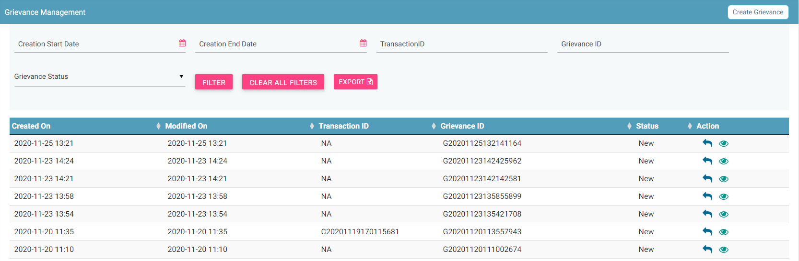
Grievance – Distributor
Report
Filters
Export
Action like View, Reply
View All grievances

Slide 15
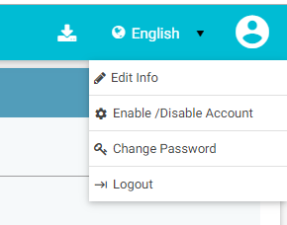
Profile Management – Distributor

Slide 16
Queries

Slide 17
Thank You

